Slide 1


VOICEGUARD AI
Defending Against AI Voice Attacks
Andrew Metcalf

Slide 2

About the Speaker
Experience
Andrew brings extensive expertise in security governance and risk management within enterprises, ensuring robust defenses against emerging threats.
Innovative Solutions
Creator of VoiceGuard AI, he focuses on cutting-edge technologies that address voice impersonation and enhance organizational security frameworks.
Commitment to Excellence
Andrew aims to bridge the gap between technical innovation and compliance, fostering a culture of security and accountability in organizations.

Slide 3
The Emerging Threat
Realistic Voice Generation
AI systems can produce highly realistic voices, imitating tone, pitch, and emotional inflections, making detection challenging for organizations.
Understanding AI-Generated Voice Deepfakes and Their Impact
Trust and Authenticity
Human psychology assigns a high level of trust to voice communication, leading to potential vulnerabilities when dealing with impersonated voices.
New Synthetic Threats
Organizations now face emerging threats from synthetic media, requiring advanced defenses against AI-driven voice impersonation techniques.

Slide 4
The Danger of Impersonation
High Trust in Voices
Human psychology inherently trusts voice communication, leading to vulnerabilities in security protocols and increasing risks of manipulation.
Understanding the Risks of Voice Fraud in Organizations
Exploitation of Familiarity
Attackers often exploit familiar voices to create an illusion of authenticity, bypassing standard verification measures and increasing fraud success rates.
Urgency and Authority
Urgency in requests can lead to hasty decisions, enabling attackers to exploit authority and manipulate targets without thorough verification.

Slide 5

Real-World Fraud Case
Consequences of Voice Cloning Attacks
A UK-based energy company was targeted in what is considered the first widely reported deepfake voice fraud attack.
Attackers used AI voice synthesis to impersonate the voice of the company’s German parent company CEO.
The attacker called the CEO of the UK subsidiary and requested an urgent transfer of €220,000 ($243,000) to a Hungarian supplier.
Because the voice matched the executive’s German accent, tone, and speech patterns, the CEO believed the call was legitimate and approved the transfer.
The money was later routed through several bank accounts in other countries before the fraud was discovered.

Slide 6
Voice Deepfakes
Exploiting Trust
Attackers utilize familiar voices to create false trust in their communications, making it easier to deceive targets into compliance.
Understanding the impact of AI voice impersonation tactics
Psychological Manipulation
Voice impersonation combines AI technology and social engineering, manipulating human emotions to exploit authority and urgency effectively.
Increasing Fraud Risk
Organizations are more vulnerable to financial fraud as voice deepfakes can bypass traditional security measures and identity verifications.

Slide 7
Red Team Insights
Voice Data Collection
Gathering extensive voice samples from public interviews enables accurate cloning of executives' voices, facilitating effective impersonation in attacks.
Understanding strategies for voice impersonation attacks
Model Training
Configuring advanced voice cloning models with collected audio enhances the realism of synthetic voices, making detection difficult for targeted organizations.
Exploiting Urgency
Impersonators leverage time-sensitive situations to bypass verification processes, increasing the likelihood of successful fraud through psychological manipulation.

Slide 8
Blue Team Perspective
Verification Protocols
Implement stringent verification protocols for financial and operational requests to minimize risks associated with voice impersonation attacks.
Strategies for Defending Against AI Impersonation Threats
Secondary Communication
Require secondary communication channels for approval processes to ensure the authenticity of urgent requests and prevent unauthorized actions.
Employee Training
Conduct comprehensive employee training programs on impersonation attack awareness to enhance vigilance against AI-generated voice fraud threats.

Slide 9
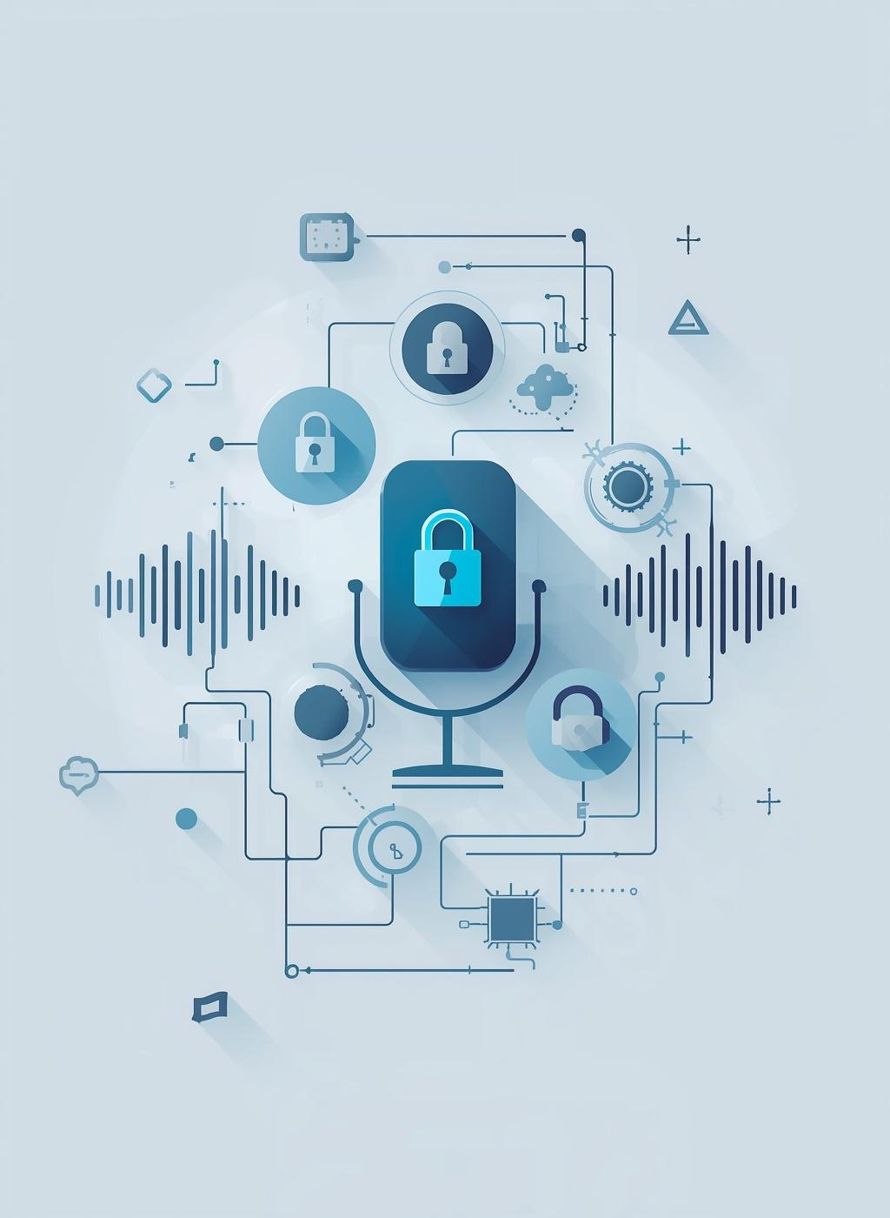
Introducing VoiceGuard AI
A breakthrough in voice detection technology
VoiceGuard AI is designed to detect synthetic voice impersonation attacks effectively. By analyzing audio patterns, it enhances organizational security against AI-generated voice threats, ensuring reliable communication authenticity and fraud prevention.

Slide 10
VoiceGuard Pipeline
Audio Input
Captured audio from recordings or live streams serves as the foundational data for VoiceGuard AI's detection mechanism.
An Overview of Detection Mechanisms and Processes
Feature Extraction
Acoustic and spectral characteristics are analyzed to identify patterns unique to synthetic voice versus genuine human speech.
Signal Analysis
Machine learning models evaluate the extracted data, generating a fraud probability score to indicate the likelihood of synthetic voice.

Slide 11
How Voice Cloning Works
Deep Neural Networks
Voice cloning utilizes deep neural networks to learn and replicate human vocal patterns, enabling realistic voice generation.
Understanding the technology behind voice synthesis capabilities
Speech Datasets
These models are trained on extensive speech datasets, capturing the nuances of tone, pitch, and emotional inflection for authenticity.
Identity Replication
The technology can recreate specific identity characteristics, making it challenging to distinguish between synthetic and genuine speech in communications.

Slide 12
Detecting Speech
Acoustic Artifacts
Synthetic voices often contain subtle artifacts that can be detected through detailed signal analysis.
Understanding the methods for identifying synthetic audio
Phoneme Irregularities
Unnatural transitions between phonemes in synthetic speech can signal a non-human origin of the audio.
Timing Inconsistencies
Timing discrepancies within speech signals may indicate synthetic audio rather than authentic human speech.

Slide 13
Deployment Challenges
Infrastructure Integration
Seamless integration of detection technologies into existing infrastructure is crucial for effective voice impersonation defense and security management.
Overcoming obstacles in enterprise AI security implementation
Communication Platforms
Integrating with communication platforms like telephony systems ensures that voice detection is applied universally across all organizational interactions.
Alert Management
Detection alerts must be efficiently incorporated into security operations workflows for timely investigations and responses to suspicious activities.

Slide 14
Integration Strategies
Alert Generation
Detection systems generate alerts for suspicious audio events, prompting security teams to investigate potential voice impersonation attempts rapidly.
Ensuring Effective Collaboration within Security Operations
Verification Processes
Analysts verify the authenticity of communications through established validation procedures, ensuring that urgent requests are legitimate before executing actions.
Incident Response
Responding to flagged events involves a structured workflow, allowing security teams to determine the legitimacy of potential fraud attempts efficiently.

Slide 15
AI Governance
Responsible Deployment
Organizations must establish governance frameworks to ensure ethical deployment of AI technologies while mitigating associated risks effectively.
Ensuring Responsible Use of Artificial Intelligence Technologies
Data Integrity
Maintaining the quality and integrity of training data is crucial for building reliable AI systems that provide accurate outputs.
Ongoing Monitoring
Continuous evaluation of AI performance helps organizations adapt to emerging threats and maintain effective security measures against misuse.

Slide 16
Enterprise AI Controls
Authorized Use
Organizations must establish controls defining permissible AI model applications and licensed datasets to ensure responsible usage in operations.
Ensuring Robust Security for AI Implementations and Use
Data Integrity
Validating the integrity of training and evaluation datasets is crucial to mitigate risks of compromised or manipulated input, maintaining system reliability.
Model Security
Implementing protections against adversarial inputs is essential to safeguard AI models from unauthorized manipulation, preserving the integrity of AI outputs.

Slide 17
Incident Response
Preparedness Plan
Organizations must establish a comprehensive incident response plan to handle potential AI-generated media breaches effectively.
Developing strategies for addressing AI-generated media incidents
Verification Procedures
Implementing secondary verification procedures can help confirm the authenticity of sensitive voice requests and mitigate fraud risks.
Continuous Training
Ongoing training programs for staff are essential to recognize and respond to synthetic media threats, enhancing organizational resilience.

Slide 18
Strategic Implications
Evolving Threat Landscape
Generative AI poses an increasingly sophisticated challenge, requiring security leaders to adapt rapidly and strengthen defenses against new impersonation tactics.
Considerations for Security Leaders in Organizations
Technology Deployment
Organizations must deploy advanced detection technologies to mitigate risks associated with AI-generated voice attacks and enhance their security posture.
Governance Framework
Establishing robust governance frameworks is essential for responsible AI usage, ensuring compliance, and maintaining security within organizational processes.

Slide 19
Future Threats
Real-Time Attacks
Preparing for the evolution of AI attack vectors
Advanced AI enables real-time voice impersonation, posing significant risks to organizations' communication integrity and trustworthiness among stakeholders.
Deepfake Fraud
Deepfake video technology targets executive communications, creating deceptive scenarios that can manipulate financial decisions and organizational actions unexpectedly.
Automated Campaigns
AI-driven social engineering campaigns increase in scale and sophistication, enabling rapid and widespread impersonation attacks across various sectors.

Slide 20
Red Team vs. Blue Team
Red Team Attack
The red team clones an executive voice and requests an urgent financial transfer, exploiting authority to bypass verification protocols.
Analyzing the Dynamics of Security Simulations
Blue Team Response
The blue team implements secondary communication verification processes, ensuring all sensitive requests are confirmed through alternative channels before action.
Prevention Measures
VoiceGuard detection system flags potential synthetic speech, allowing security analysts to investigate and prevent fraudulent transactions effectively.

Slide 21
Key Takeaways
Evolving Threats
Generative AI transforms social engineering, increasing impersonation and fraud risks for organizations in various sectors.
Understanding the impact of AI voice technology
Detection Systems
Implementing systems like VoiceGuard identifies synthetic speech, helping organizations mitigate risks associated with AI-generated voice attacks.
Governance Frameworks
Establishing robust governance ensures responsible AI usage, aligning technology with security policies and compliance standards for organizations.

Slide 22

What Are Your Thoughts?
Open floor for discussion and questions today

